Slide 1
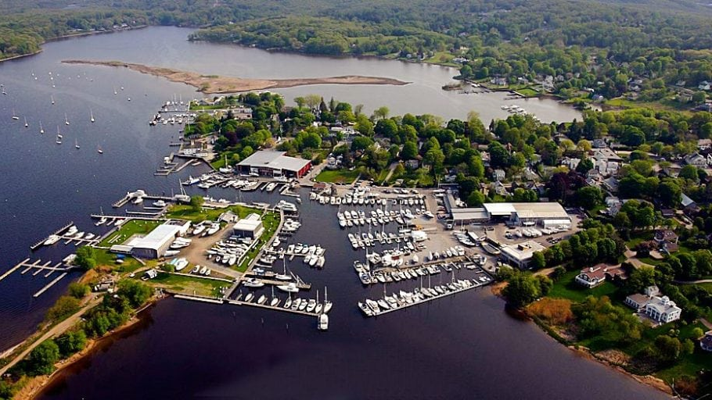
The Village of Essex
Transportation Master Plan
Andrew Clark, Yogesh Yagnik, Stephanie Bogue, Sheila Khayami
Department of Civil Engineering
University of Connecticut
Notes:
Hello everyone, my name is blah de bloo de blahhh…...introductions
In _____ we presented a proposal of a transportation master plan to look at the challenges to consider, primary research and observations, and potential options to consider. So today we are going to present two main alternatives, but before that I am just going to go through the history before we present the alternatives.
The alternatives that you will see later on have upheld the historic aspect of the Village of Essex as well as increasing the sense of place in the town.
General Outline / Intro - Andrew
Transportation in Essex Village, historically - Sheila
Data collected & decisions - Yogesh
Design option A & pricing - Andrew & Steph
Design option B & pricing - Andrew & Steph
Modular Design - things that can be mixed and matched depending on preference and budget - individual prices for things like different materials, different types of angled parking, etc. - TBD...
Other options to consider - Tactical Urbanism - Yogesh?
Conclusion - Anyone...

Slide 2
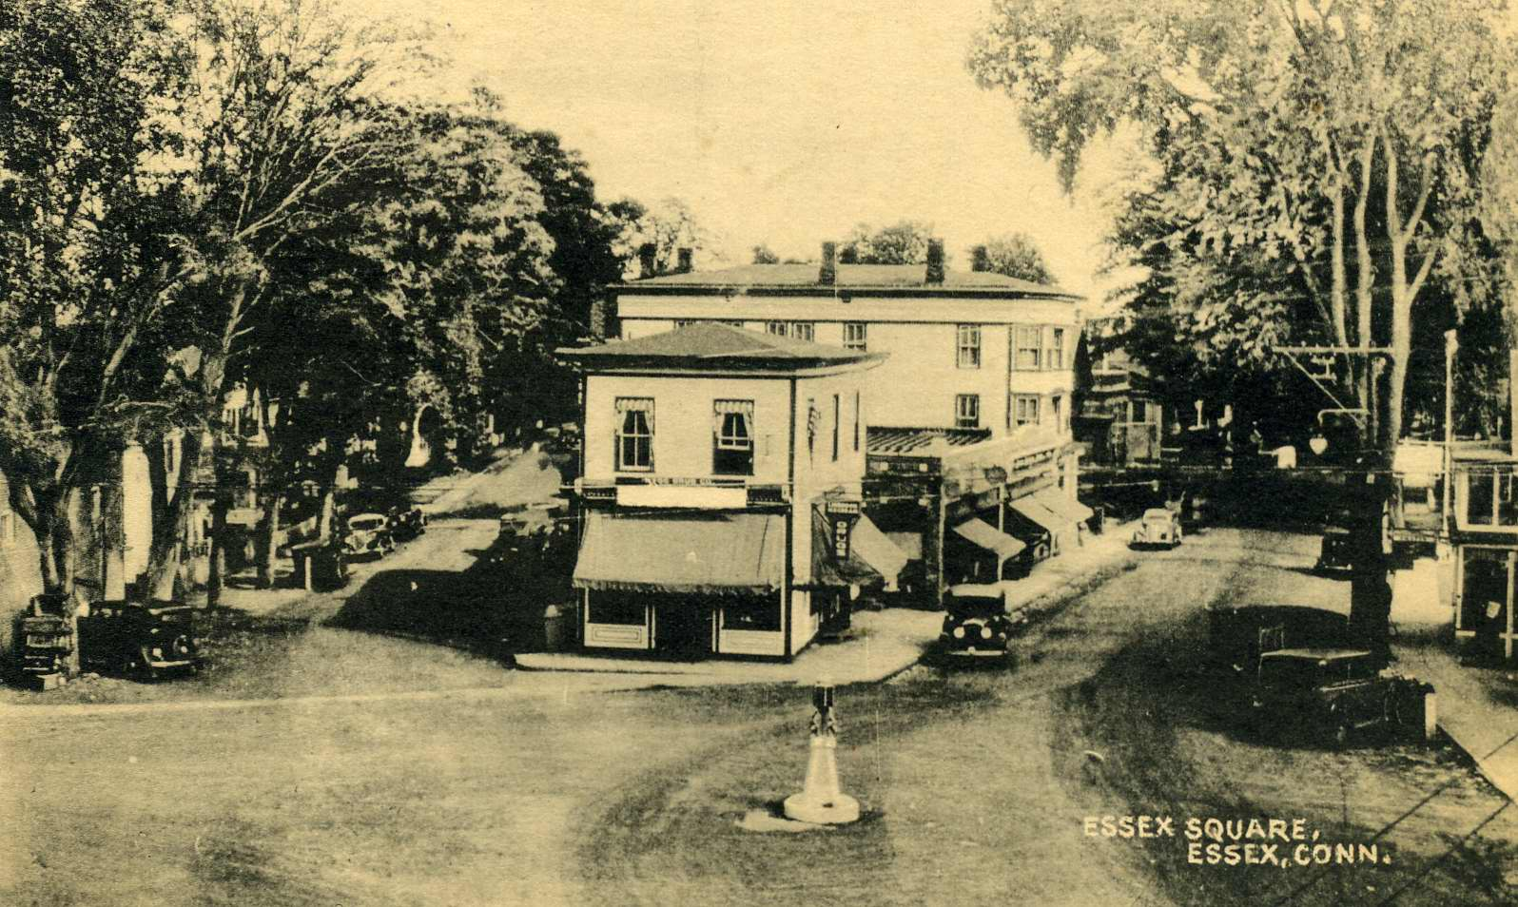
Transportation in Essex Village,
Historically

Slide 3
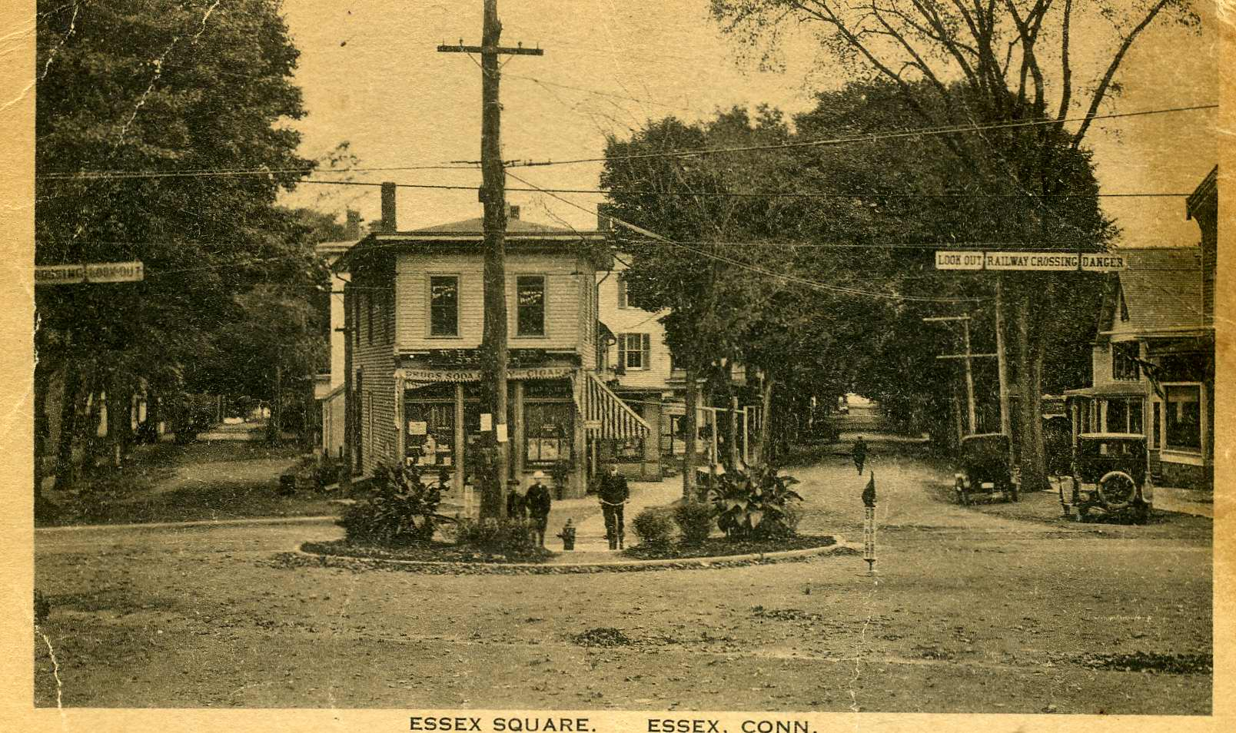
Traffic Circle
Notes:
As you can see, there was a traffic circle where the silent policeman is currently. This picture I believe was taken in the early 20th century

Slide 4
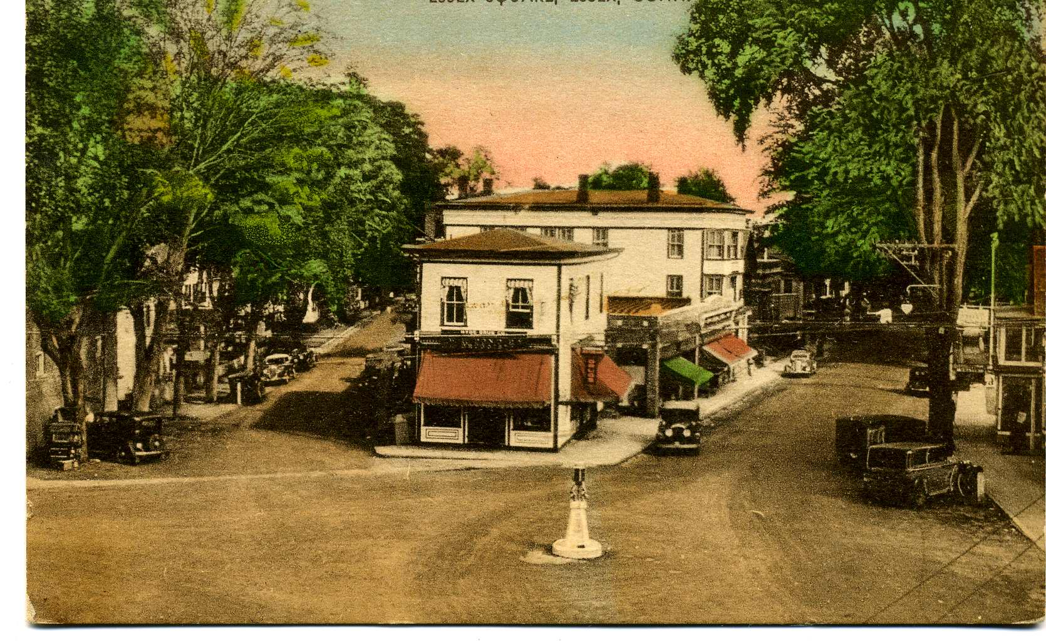
Traffic Circle
Notes:
And now later in the 20th century current day there is a silent policeman. We do not know why this was changed, but as you can see the traffic circle looks the same as current day.

Slide 5
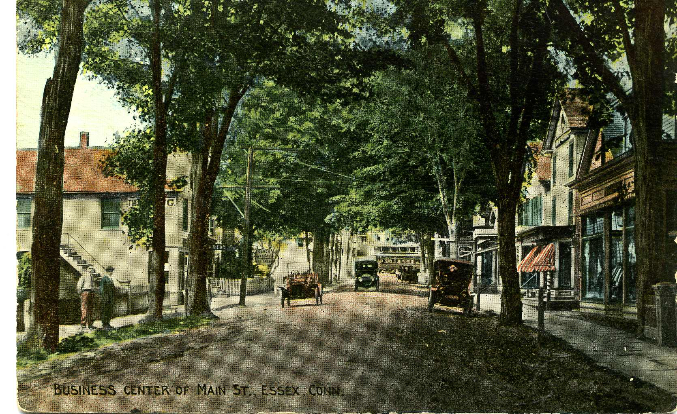
Main Street
Notes:
As you can see, this is a picture of Main Street from the 1900s??????

Slide 6
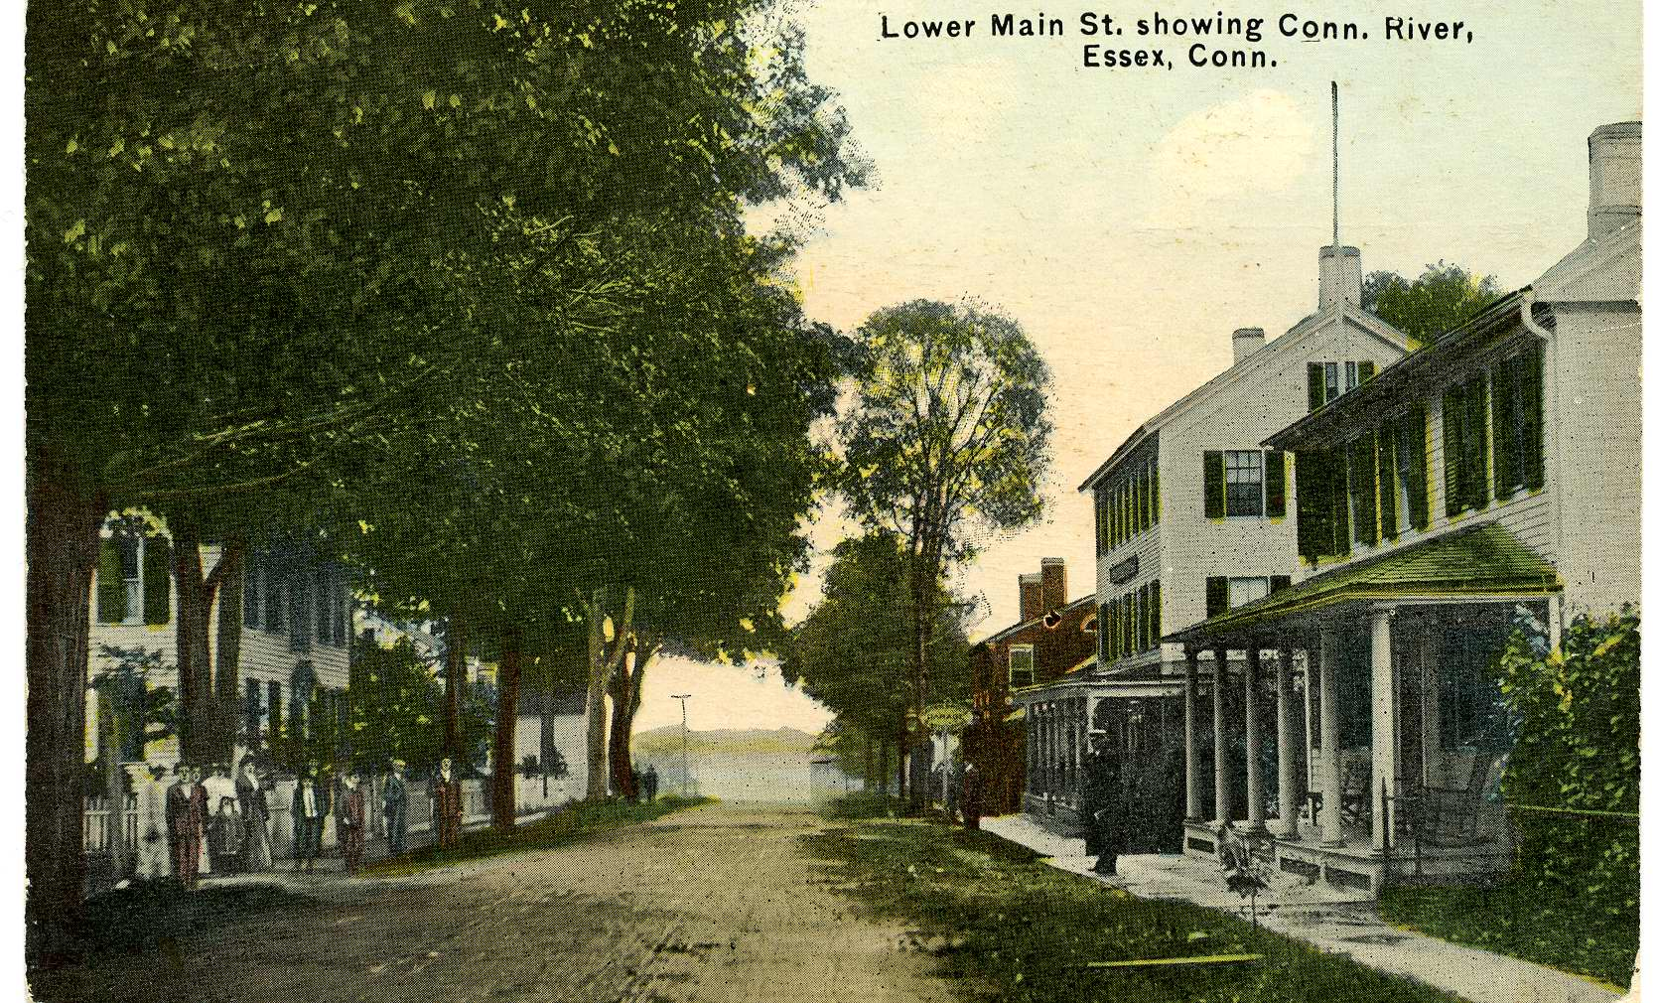
Lower Main Street
Notes:
This is also a picture of Main Street that is facing the Connecticut River and the boat dock

Slide 7
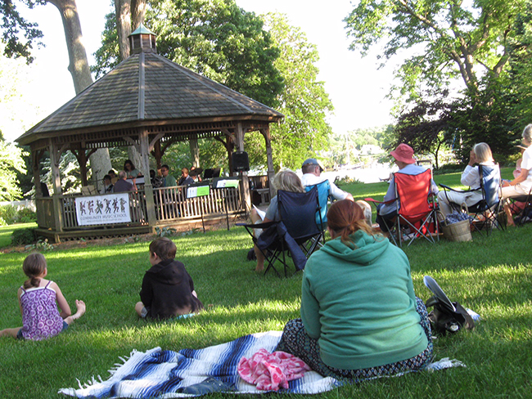
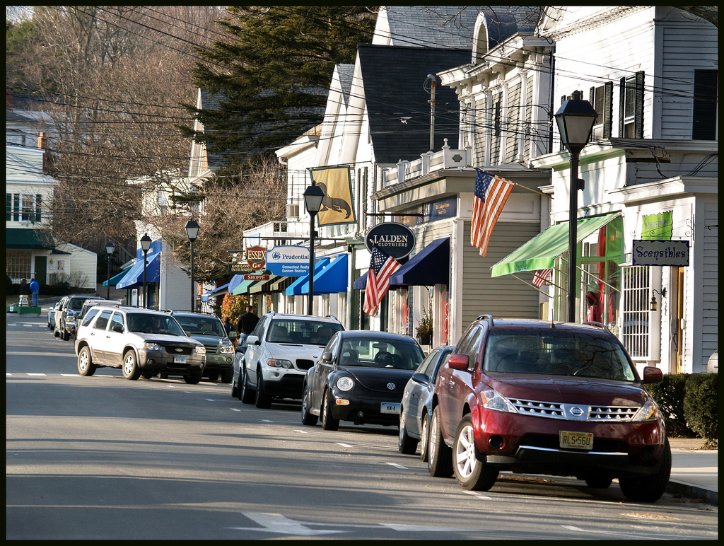
Strong Sense of Place
Notes:
Talk about why it’s special (historical fabric) - urban fabric, strong sense of community, etc.
Vibrant, live, work, play
Make more walkable, bikeable, better use of parking, better entrance (more presence)
Move slides for sense of place here
Some of sense of place eroded over time and talk about issues
Entrance, pedestrians, facilities for people on foot
Flooding causing concerns because some streets might not be available (rising sea level)
Pattern of parking use - existing/where/owned by whom
Show amount of space that’s available for parking
Talk about limiting factors

Slide 8
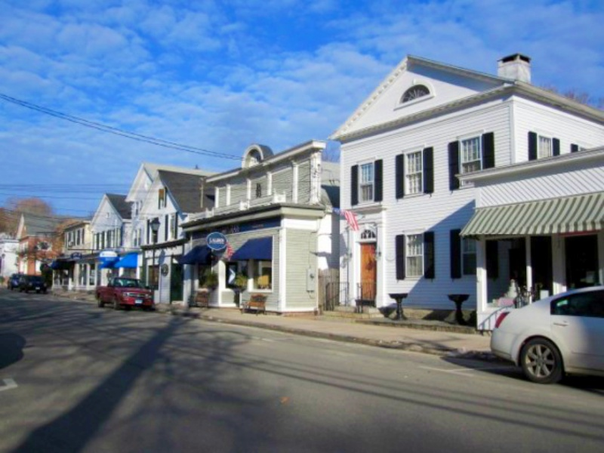
Some sense of place has eroded
What can be done to enhance space?
Notes:
Talk about why it’s special (historical fabric) - urban fabric, strong sense of community, etc.
Vibrant, live, work, play
Make more walkable, bikeable, better use of parking, better entrance (more presence)
Move slides for sense of place here
Some of sense of place eroded over time and talk about issues
Entrance, pedestrians, facilities for people on foot
Flooding causing concerns because some streets might not be available (rising sea level)
Pattern of parking use - existing/where/owned by whom
Show amount of space that’s available for parking
Talk about limiting factors

Slide 9
Observations & Data Collected

Slide 10
Source: Google Maps & StreetMix
5’
8.5’
23’
8.5’
5’

Slide 11
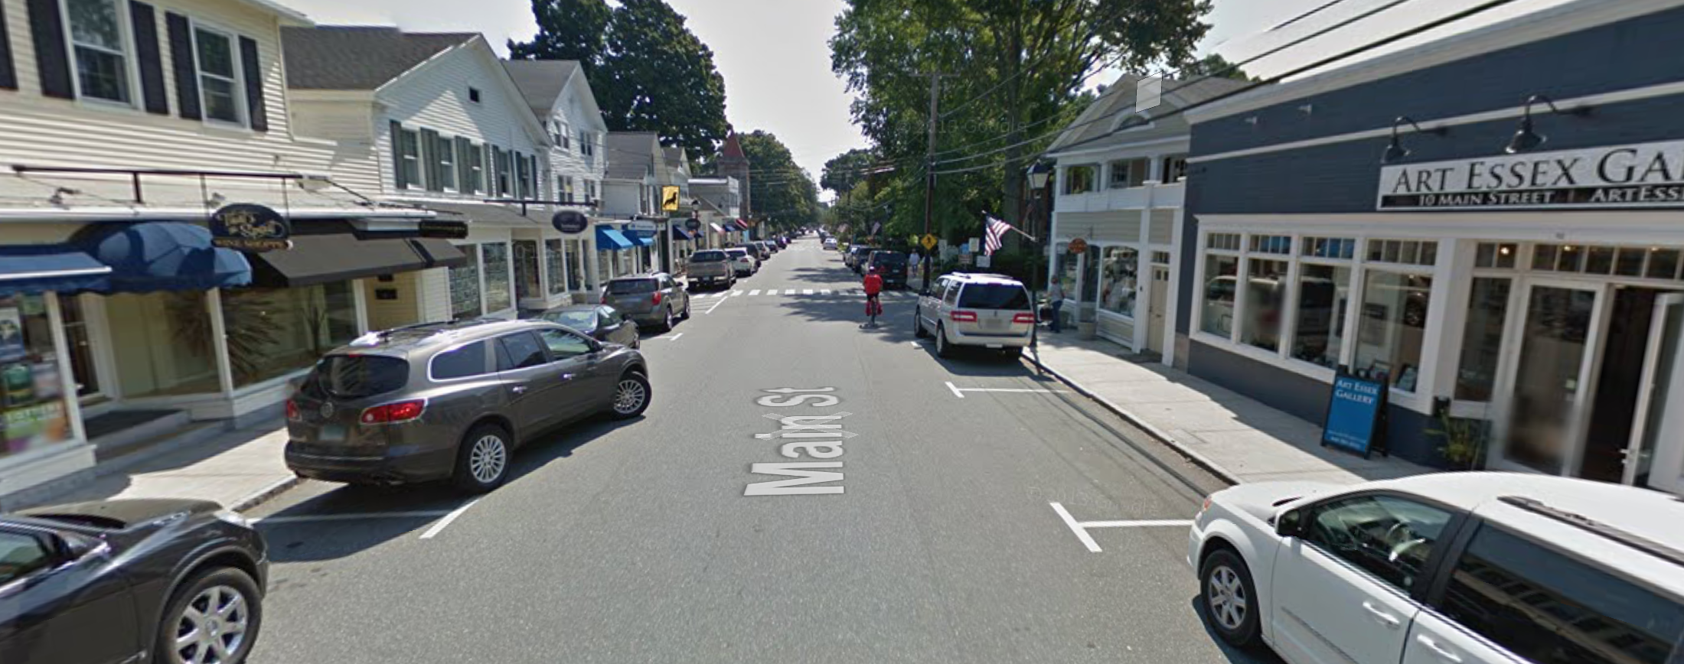
Source: Google Maps & StreetMix

Slide 12
Source: Google Maps & StreetMix
10’
21’

Slide 13
Source: Google Maps & StreetMix
8’
15’
8’

Slide 14
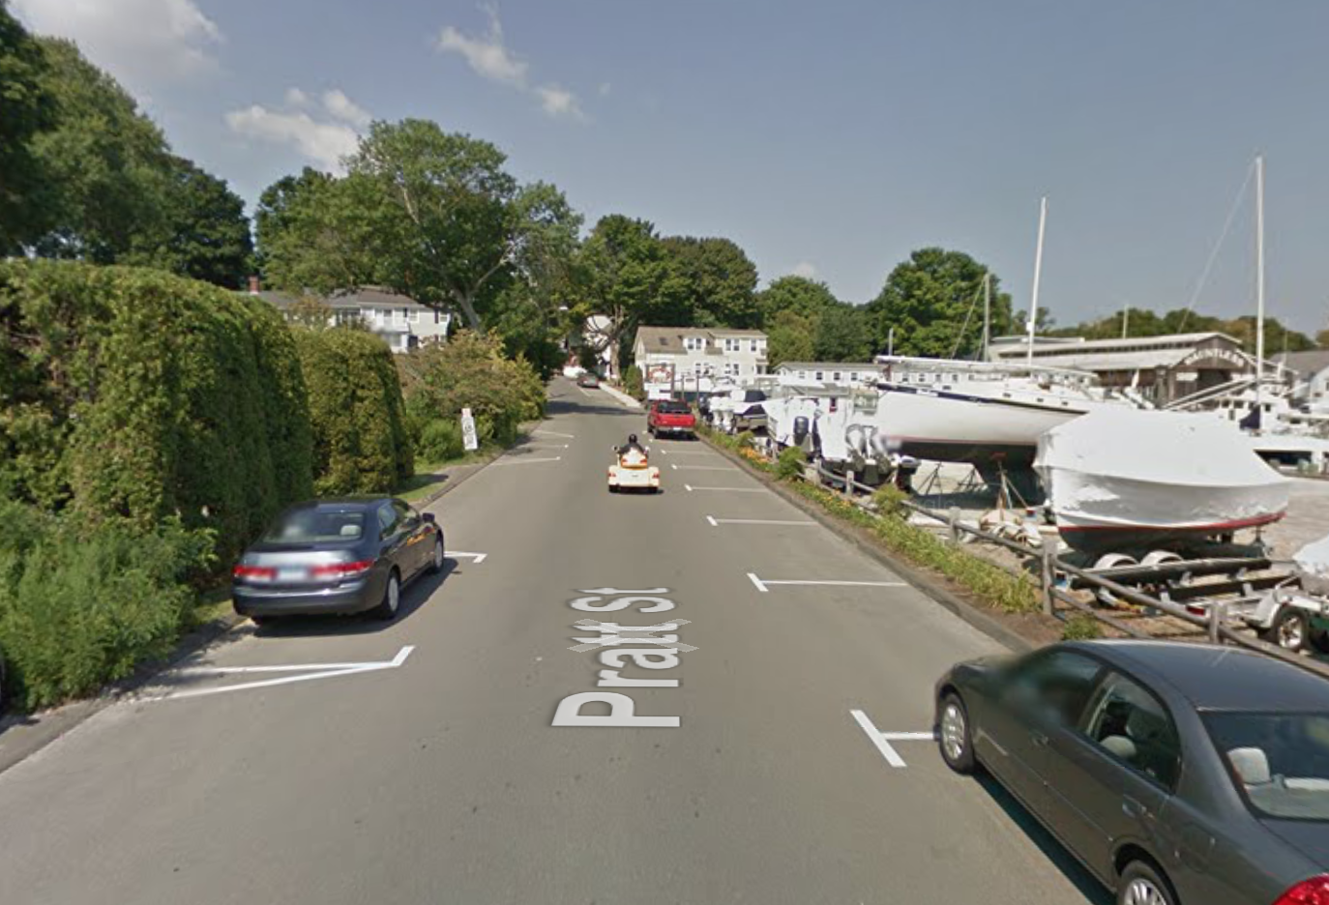
Source: Google Maps & StreetMix

Slide 15
Source: Google Maps & StreetMix
3’
8’
11’
8’
4’

Slide 16
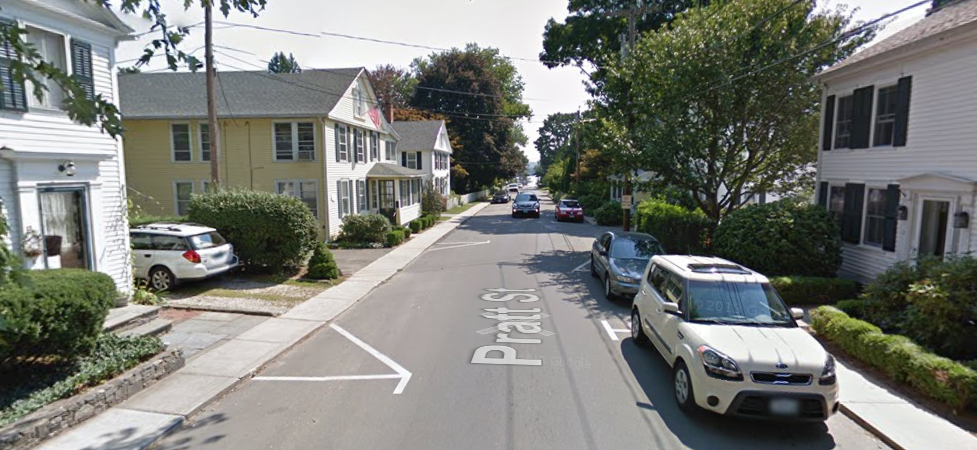
Source: Google Maps & StreetMix

Slide 17
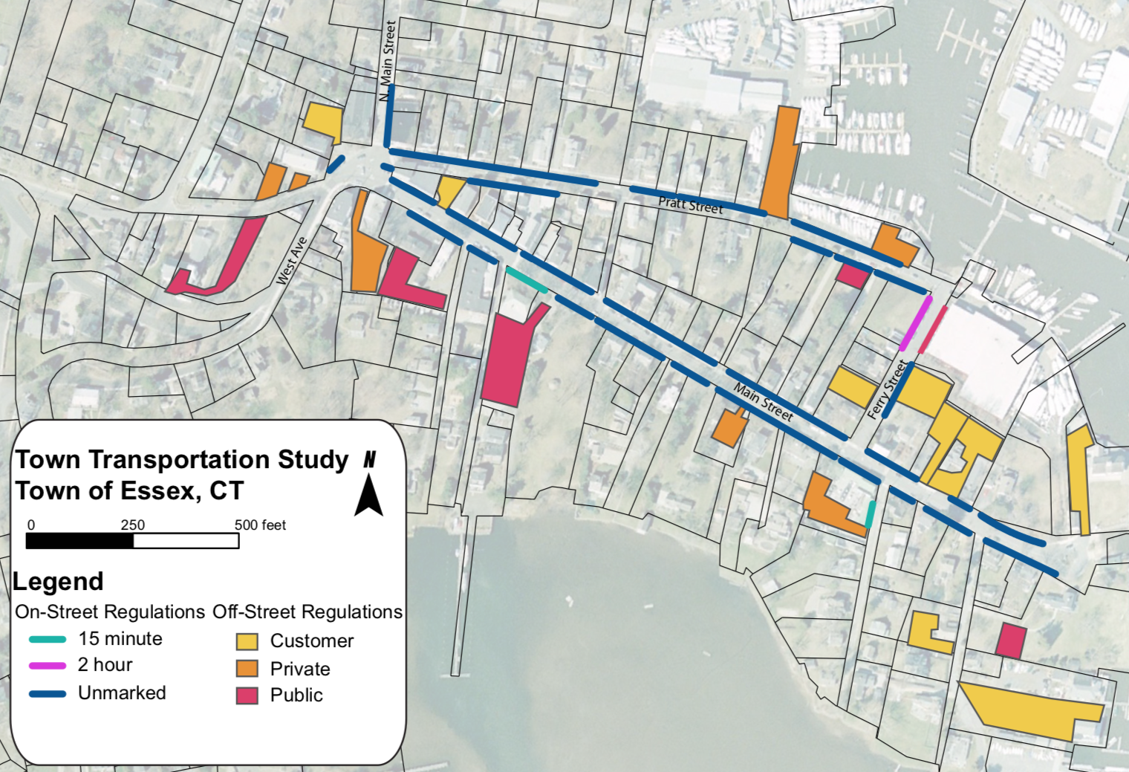
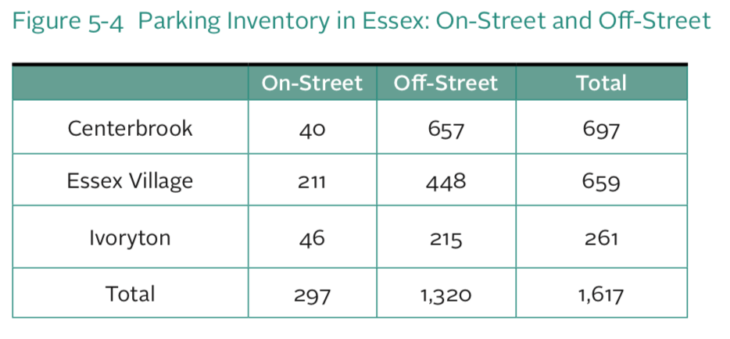
Existing Parking Count
Source: Transportation Study Vol. I
Notes:
Point out that in any design case, off-street parking will remain unchanged

Slide 18
Existing Parking Count
Location | Observed On-Street Count
Traffic Circle | 8
Main Street | 120
Ferry Street | 12
Pratt Street | 52
Total | 192
Notes:
Point out that in any design case, off-street parking will remain unchanged

Slide 19
Design Option A

Slide 21
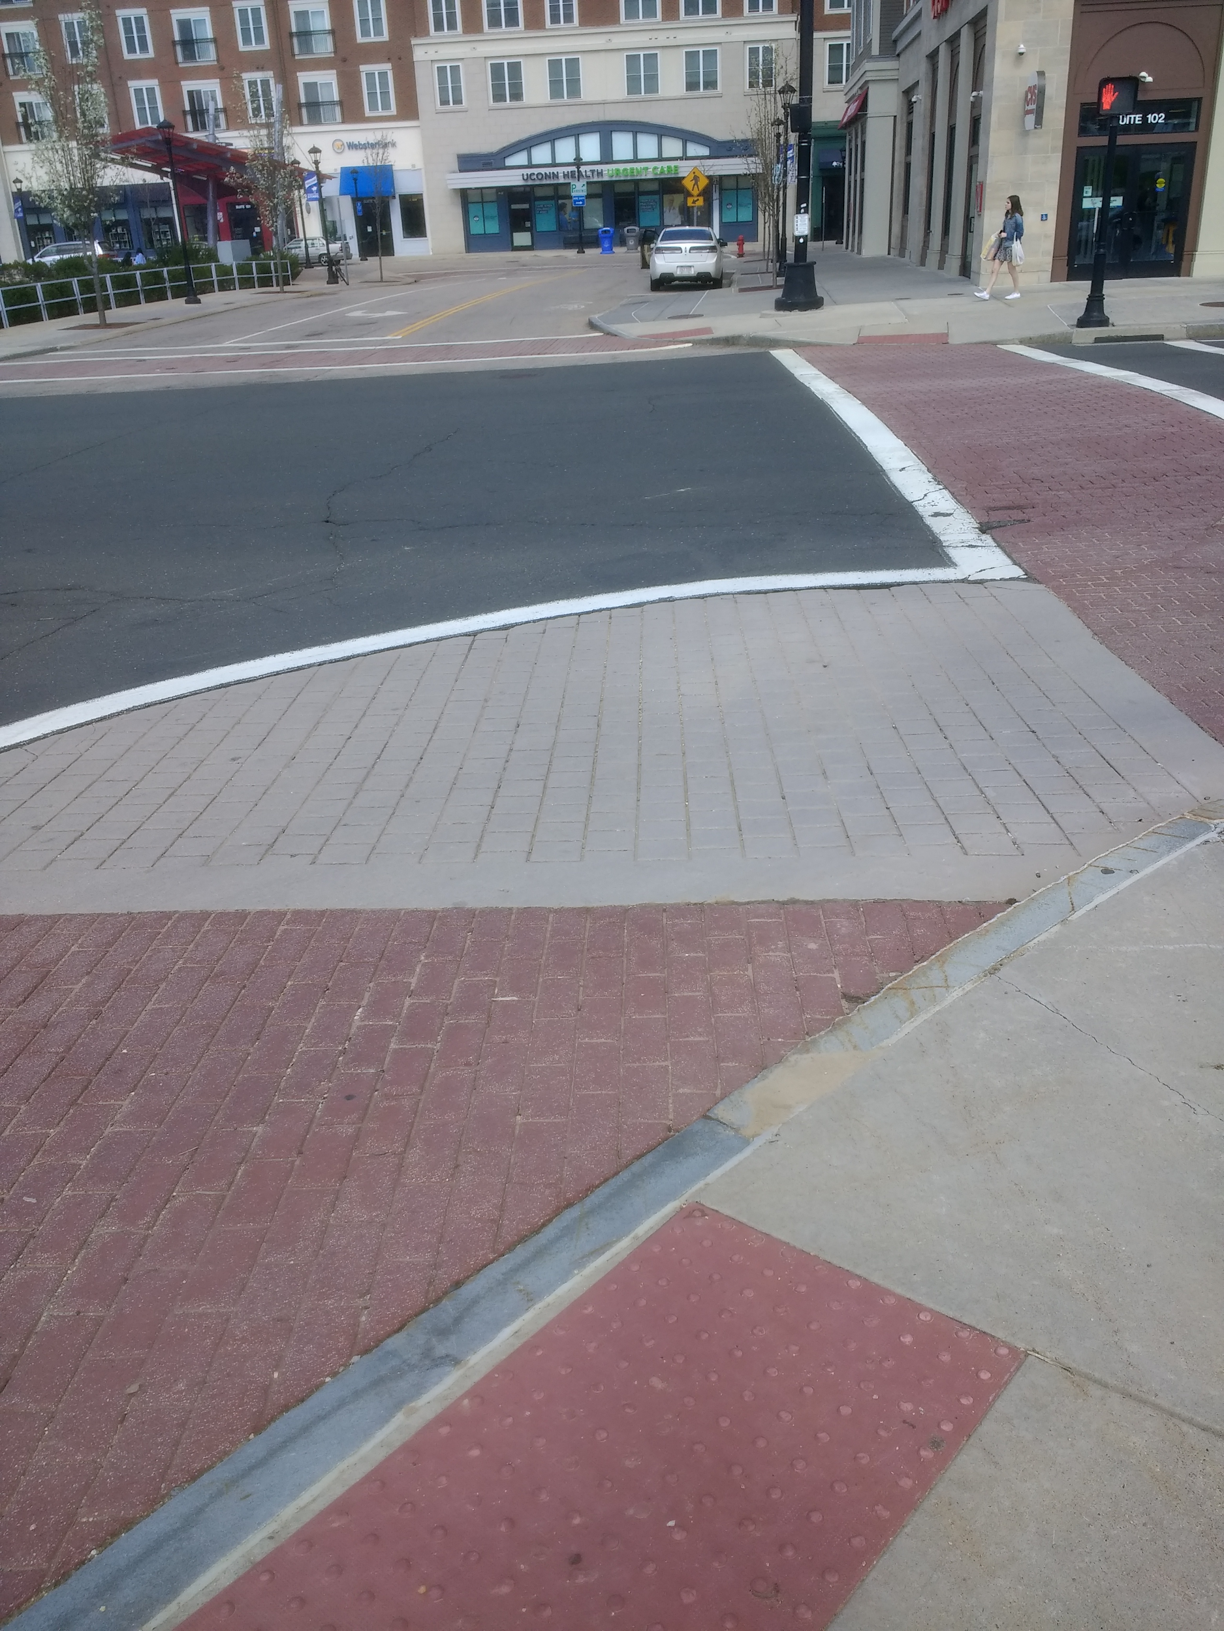
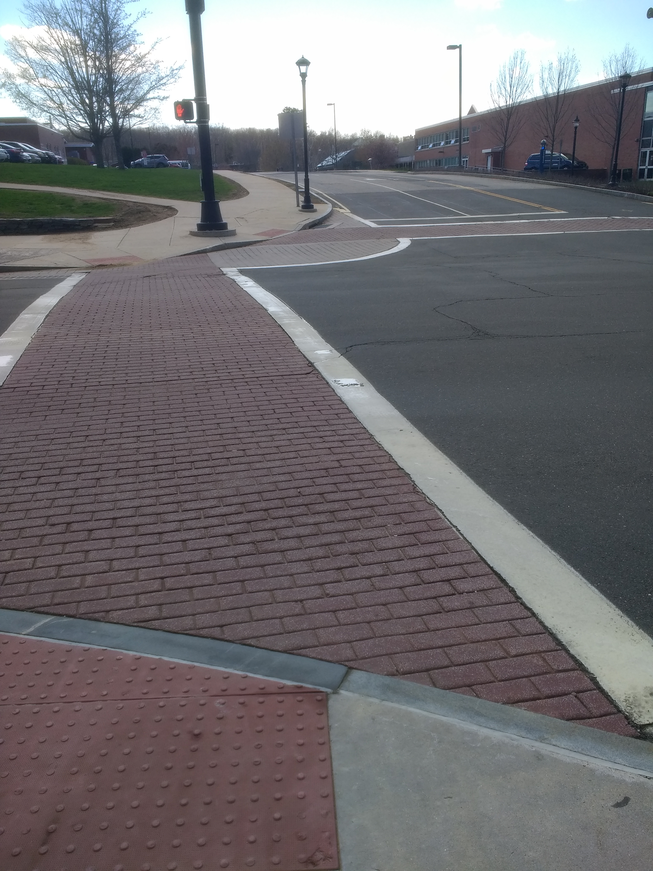
Storrs Center,
Storrs, CT

Slide 22
Pedestrian Refuge
Mansfield Road,
Storrs, CT

Slide 24
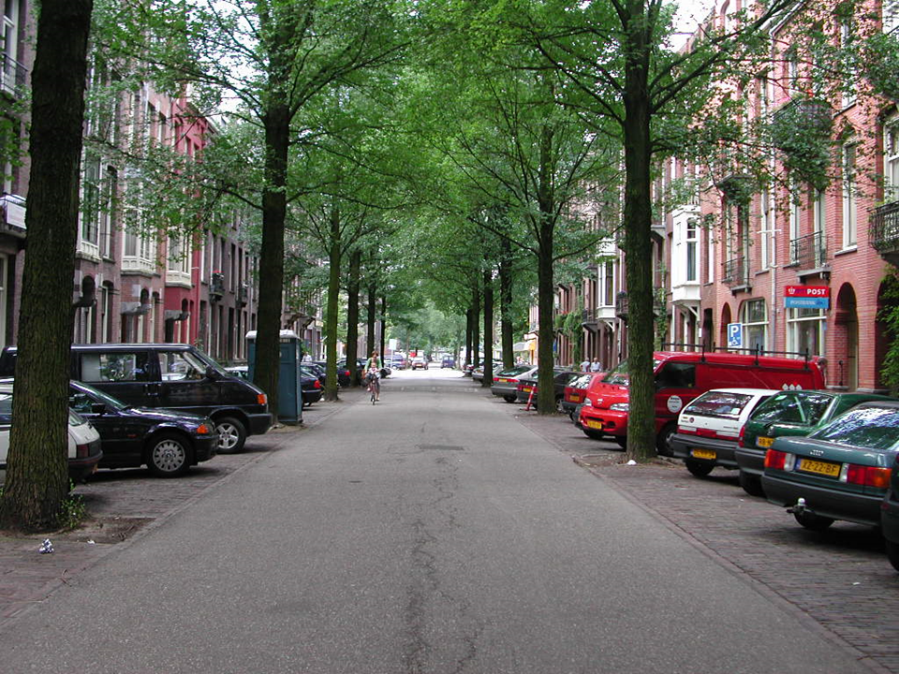
Williempark,
Amsterdam, NL
Notes:
Neighborhood called William Park

Slide 25
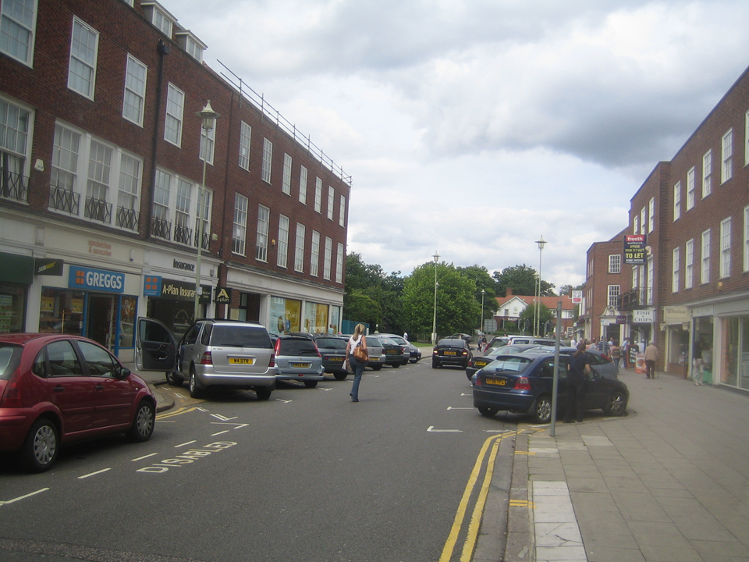
Notes:
Designed as factory town

Slide 27
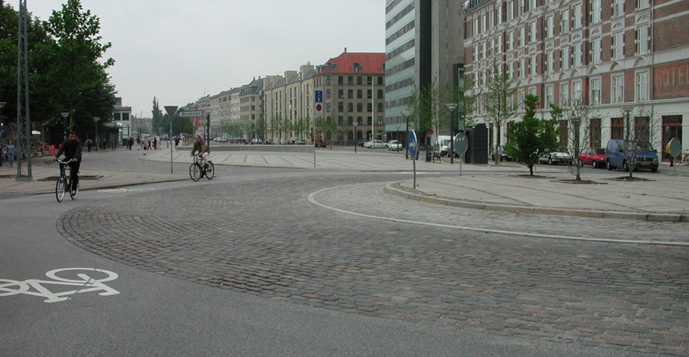
Truck Apron
Notes:
Get rid of gas station picture

Slide 29
Bioswales - to manage flooding
Lower Merion Township, PA

Slide 30
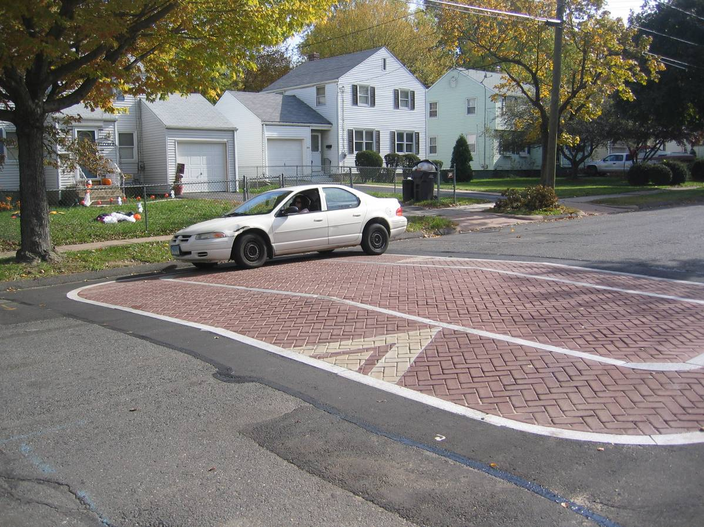
Raised Speed Table

Slide 31
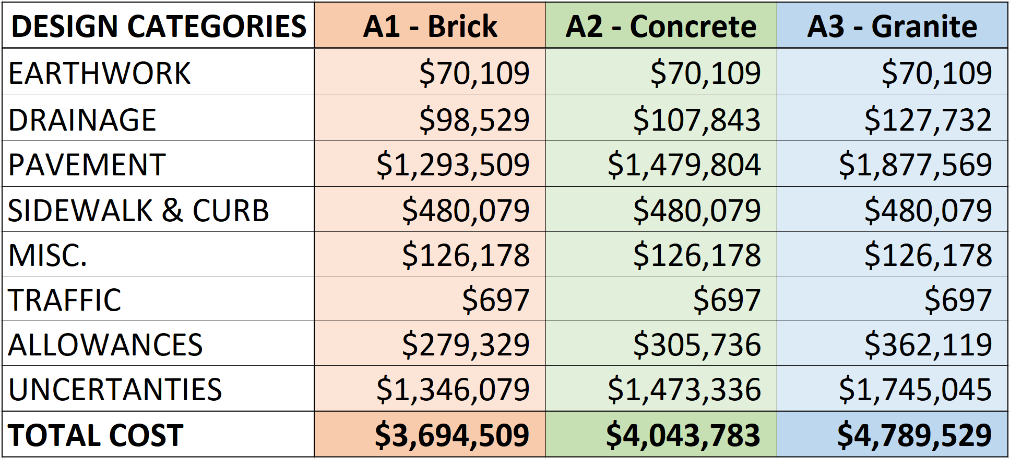
Cost Estimate: Alternatives A1, A2, A3
Notes:
This is a summary of the different expense categories for the concept design’s cost estimate
The columns for brick, concrete, and granite represent different levels within the selection of paving materials for the Alternative A design
Reference the light and dark grey hatch marks in the design
In order of increasing cost
The “Pavement” category is what contains the changed materials and has the most significant price difference between options
The purpose of providing different materials in the 3 cost options is to illustrate that the design is more about physical layout of the street, rather than specific material requirements
Flexible depending on the available budget budget/what would best suit Essex Village
Within come design categories, several assumptions were made about the drainage, allowances, and uncertainties
Were assumed to be a percent of the project subtotal
Allowances: Clearing & Grubbing (2%), M&P of Traffic (4%), Construction Staking (1%), Mobilization (6.5%)
Uncertainties: Minor Item Allowances (20%), Contingency (25%), Inflation (3.5% x 2 years)

Slide 32
Design Option B

Slide 34
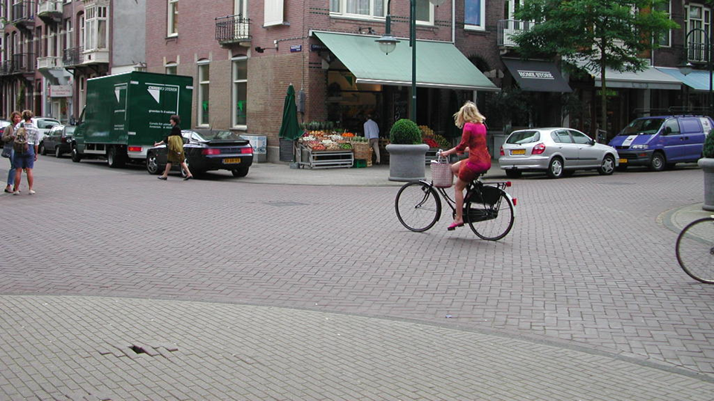
Cornelis Schuytsrtaat,
Amsterdam, NL
Exhibition Road, London, UK
Notes:
Cornelius Trat???

Slide 35
Notes:
Show traffic flow

Slide 36
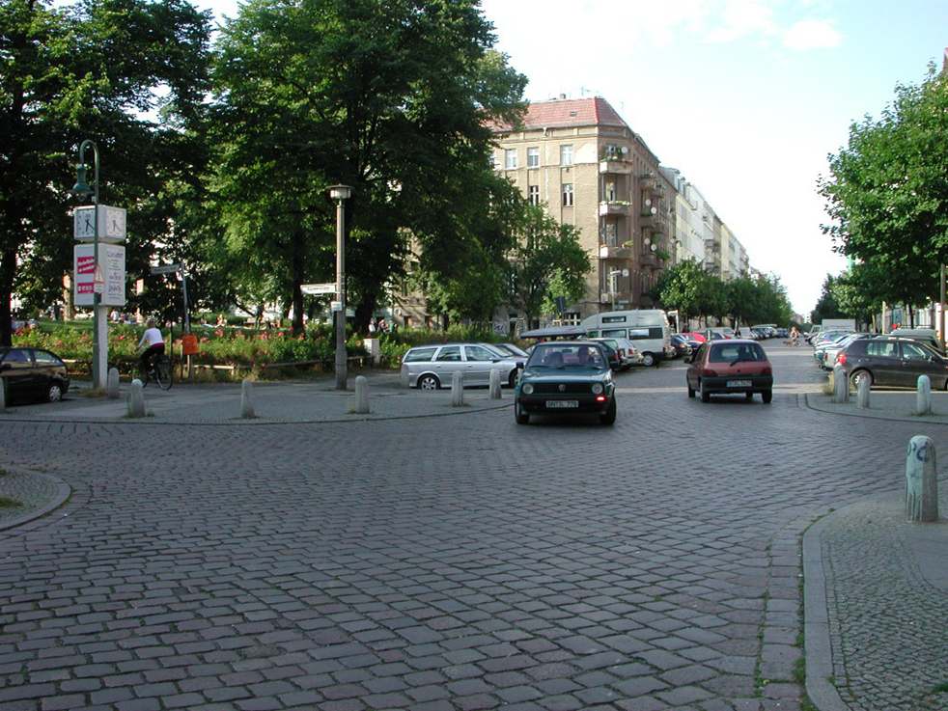
Raumerstrasse,
Berlin, Germany

Slide 37
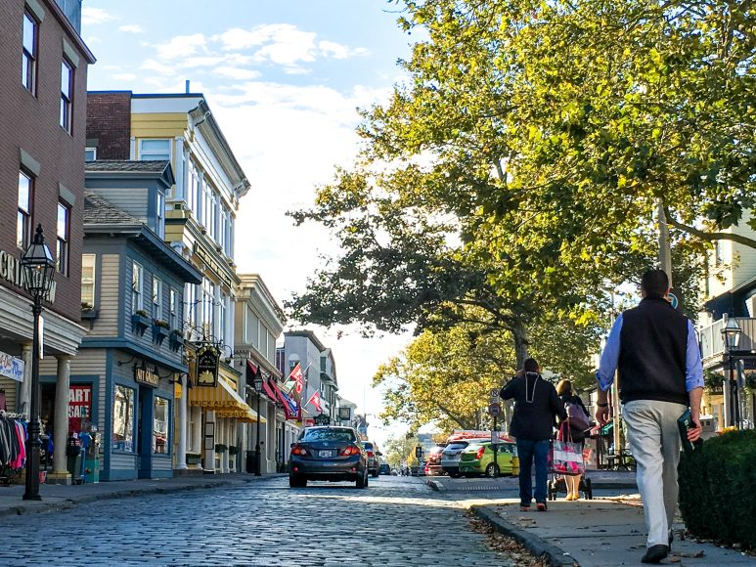
Thames Street,
Newport, RI
Notes:
Get rid of blurry picture

Slide 38
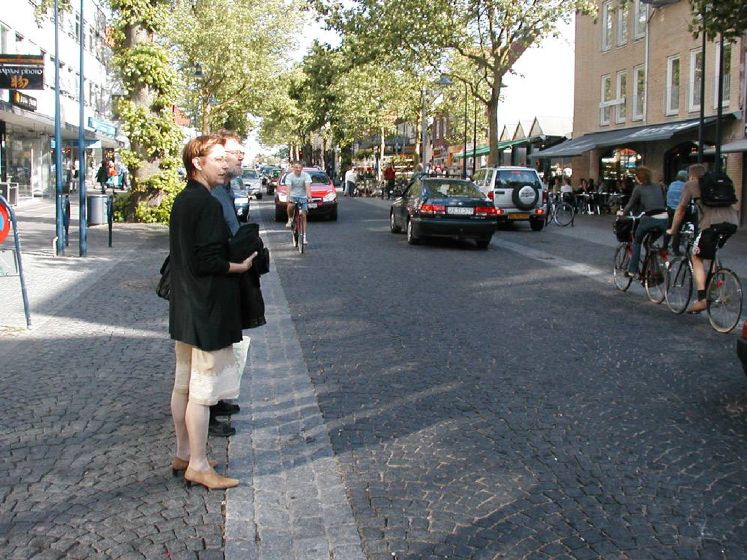
Lyngby Hovedgade, Lyngby, Denmark

Slide 42
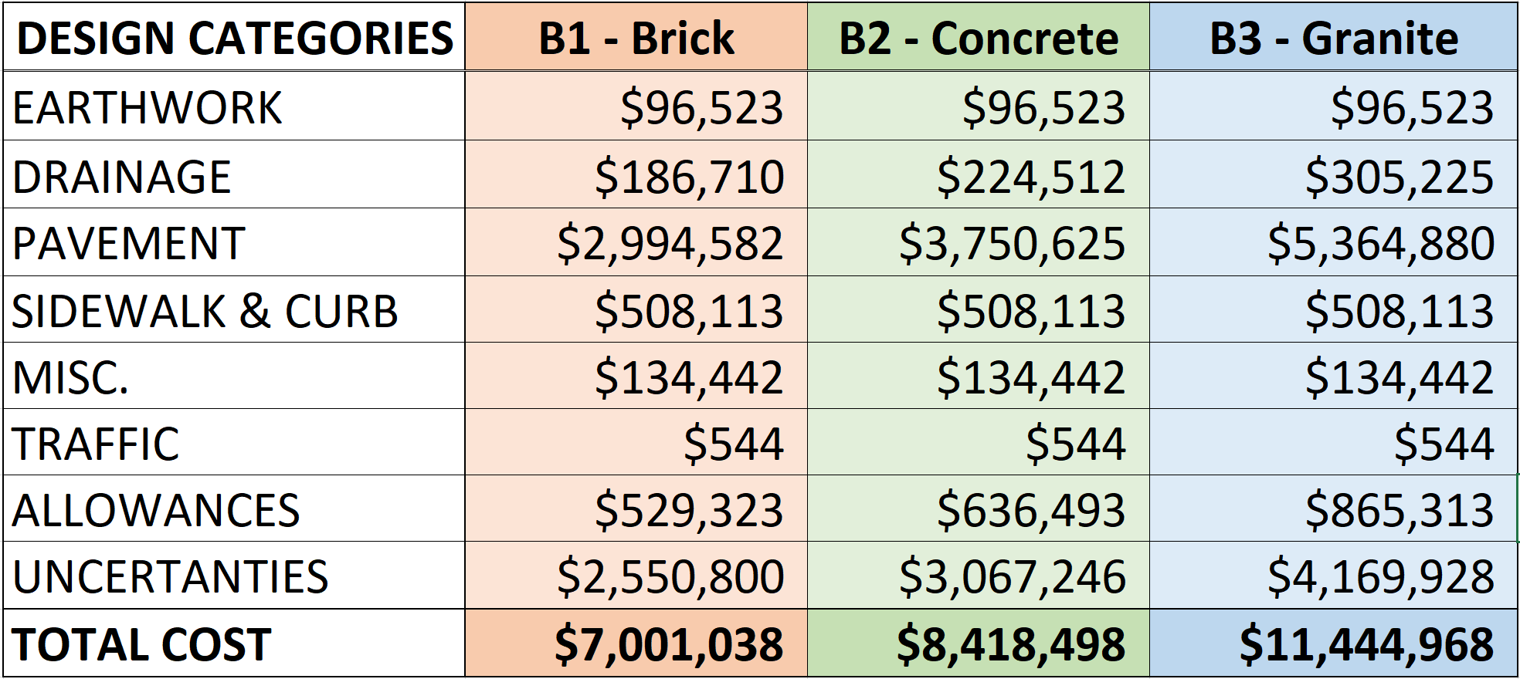
Cost Estimate: Alternatives B1, B2, B3
Notes:
This is a summary of the different expense categories for the concept design’s cost estimate
The columns for brick, concrete, and granite represent different levels within the selection of paving materials for the Alternative A design
Reference the light and dark grey hatch marks in the design
In order of increasing cost
The “Pavement” category is what contains the changed materials and has the most significant price difference between options
The purpose of providing different materials in the 3 cost options is to illustrate that the design is more about physical layout of the street, rather than specific material requirements
Flexible depending on the available budget budget/what would best suit Essex Village
Within come design categories, several assumptions were made about the drainage, allowances, and uncertainties
Were assumed to be a percent of the project subtotal
Allowances: Clearing & Grubbing (2%), M&P of Traffic (4%), Construction Staking (1%), Mobilization (6.5%)
Uncertainties: Minor Item Allowances (20%), Contingency (25%), Inflation (3.5% x 2 years)

Slide 43
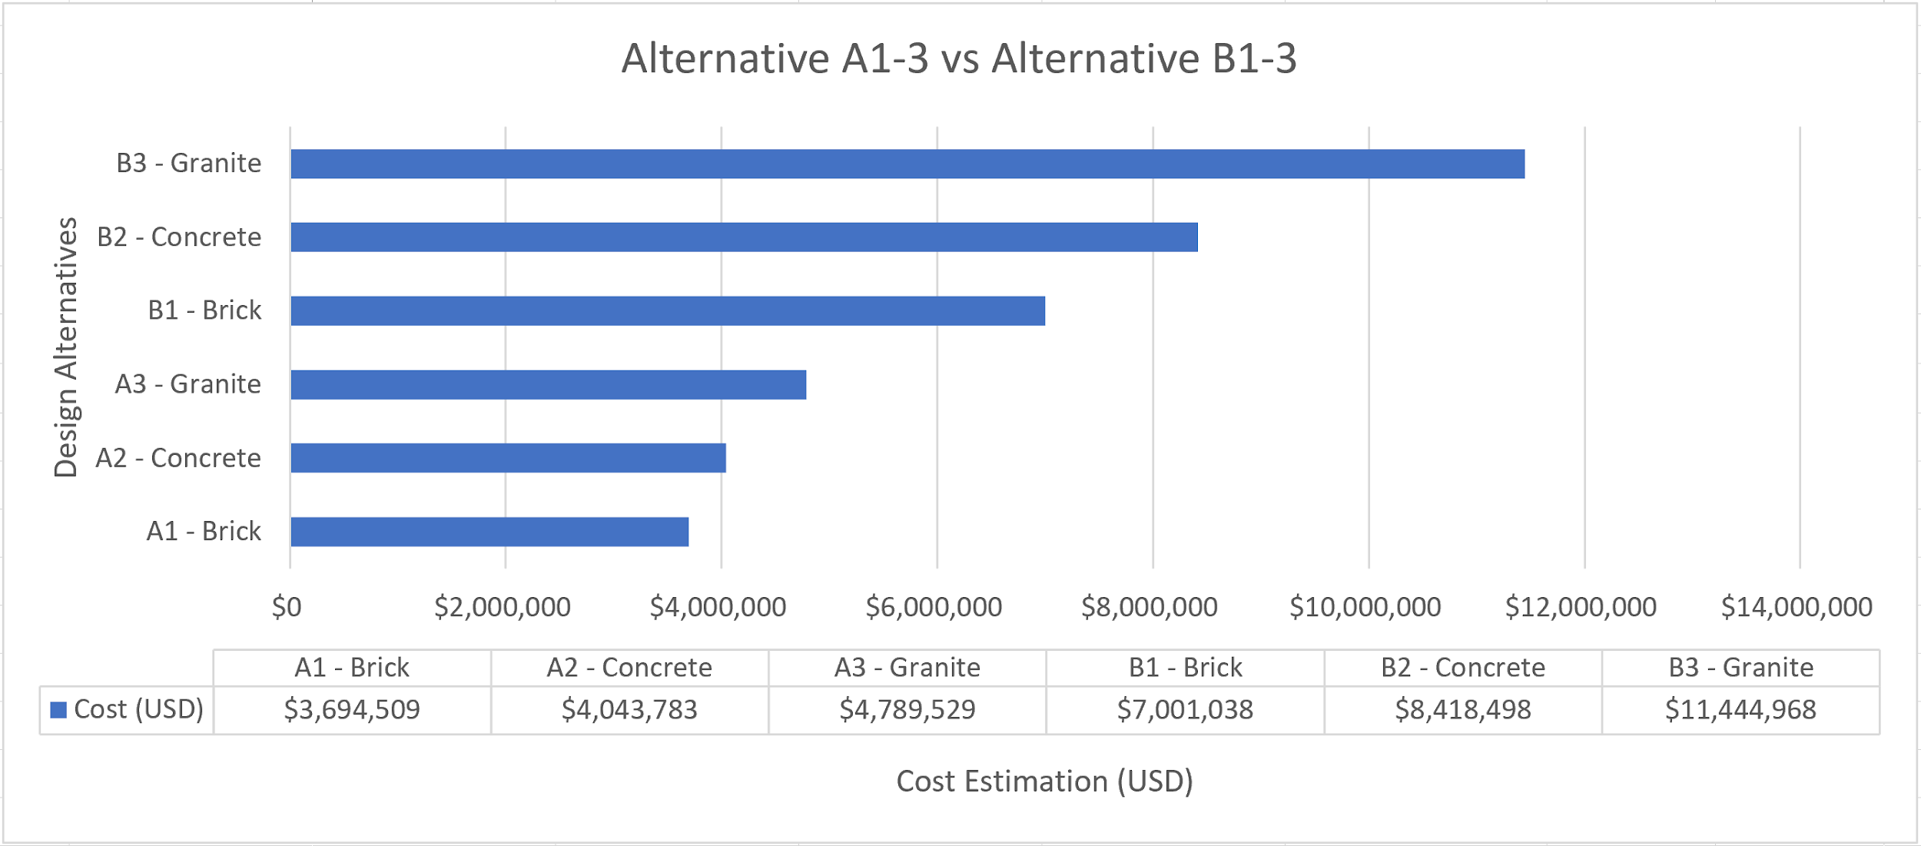
Cost Estimate Comparison
Notes:
This graph provides a visual comparison between all the material options within the designs for Alternatives A and B
Again, the purpose of the different street materials is to draw attention to the actual design
The materials for the concepts can be selected based on the available budget and what would best serve the village
Noticeable cost difference between the A1 and B3
Due to selection of primary street/paving material
This lends itself to the concept known as “Modular design”
Can select which items from either alternative to combine into new design that best fits needs/budget
Specific items can be implemented individually
Mixed and matched to align closer to a budget that is more comfortable
Examples: type and location of parking (reverse or forward angle, parallel), bioswales/rain gardens, brump-out locations, different street materials and the extent to which they are used, etc.

Slide 44
Another Potential Option...
Tactical Urbanism

Slide 45
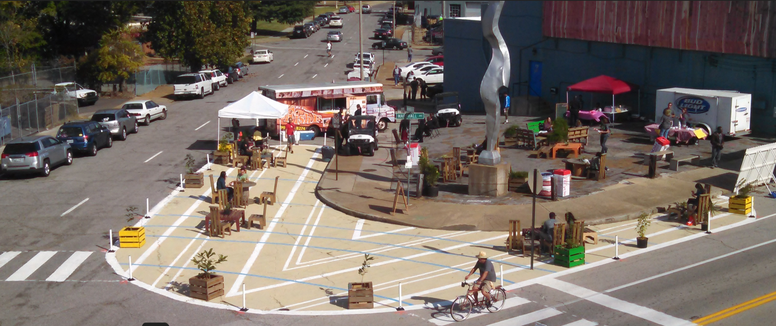
What is Tactical Urbanism?
Lighter
Quicker
Cheaper
Memphis, TN

Slide 46
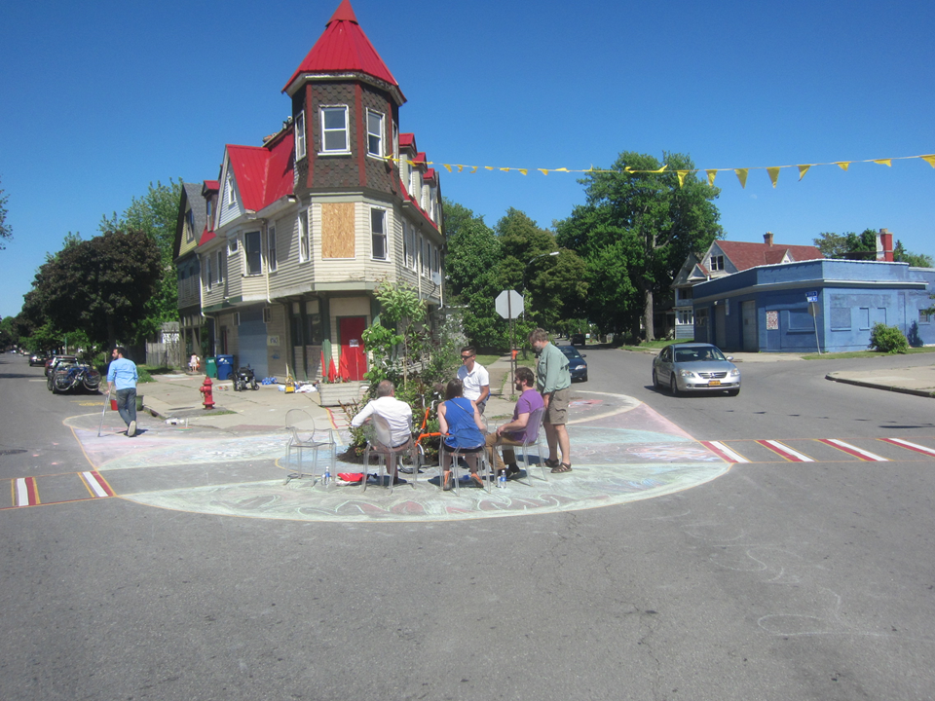
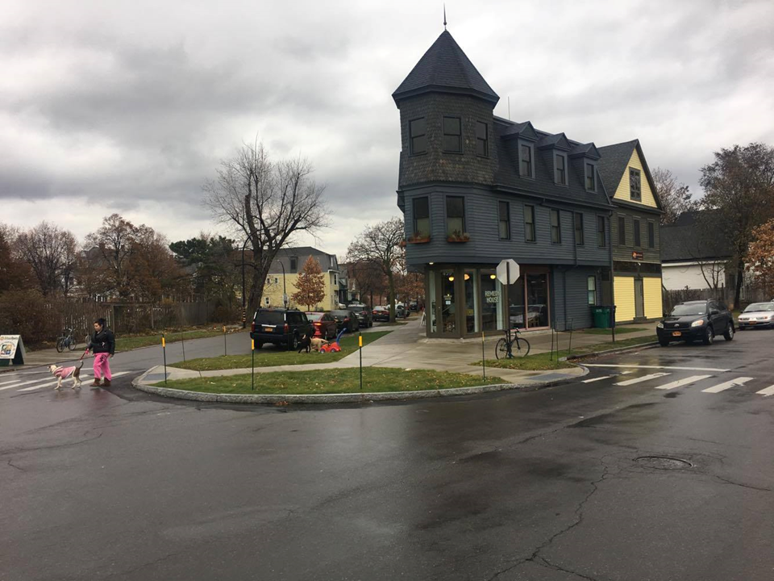
A Test Trial...
Five Corners,
Buffalo, NY

Slide 47
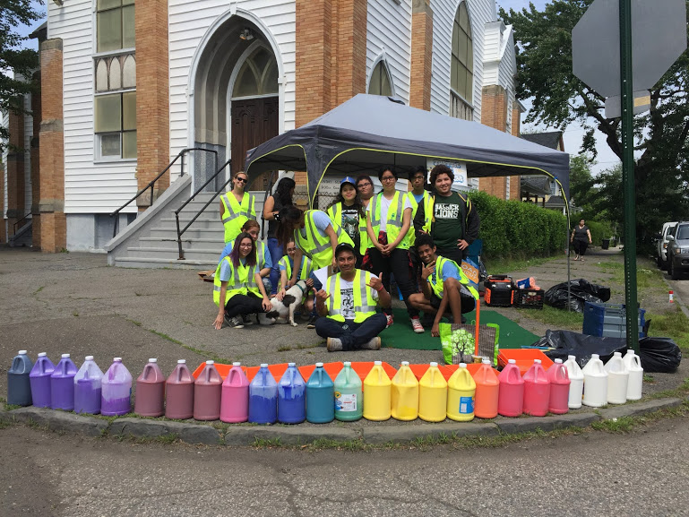
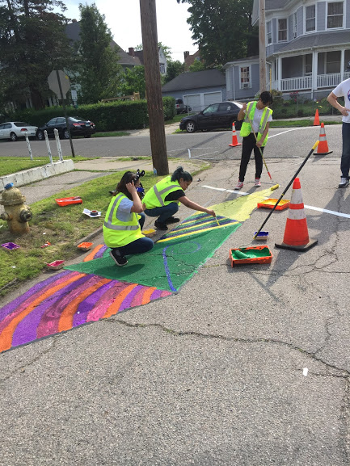
Community Building...
Bridgeport, CT

Slide 48
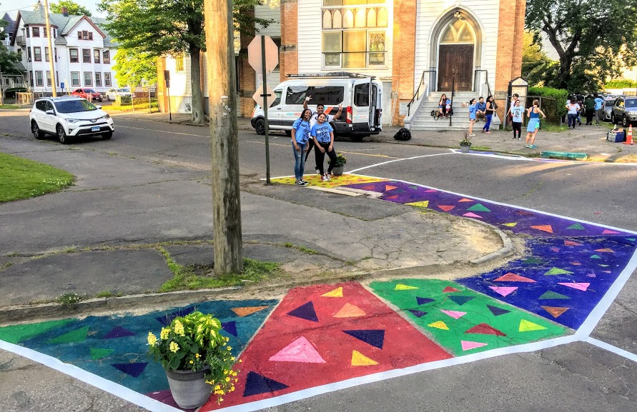
Bridgeport, CT

Slide 49
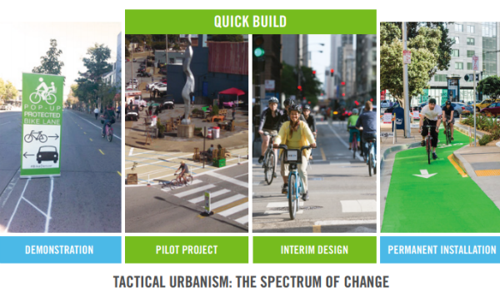

Slide 50
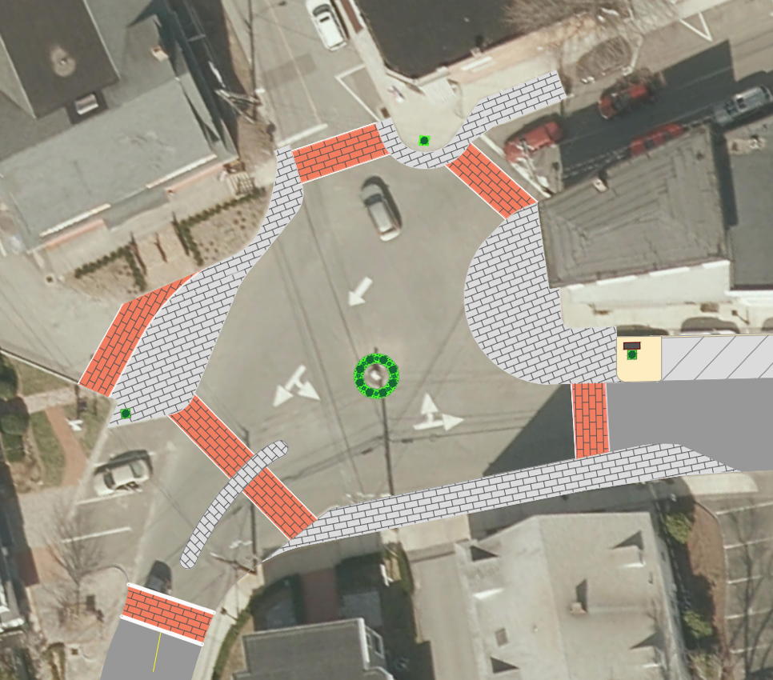
Why should you consider it?
Good way to try certain changes without needing to put in the full cost
Examples of applications in Essex
Bump outs
Extensions within traffic circle
Center of circle expansion
Notes:
Animations for which arrow points to what area (only some of them)

Slide 51
Acknowledgements
Town of Essex Economic Development Committee
Janet Peckinpaugh
Susan Malan
Melissa Josefiak - Essex Historical Society
Joel Marzi - Town Clerk
Sam Goater - Western Conn. Council of Governments
Dr. Norman Garrick - Project Advisor

Slide 52
Questions?

